Slide 1
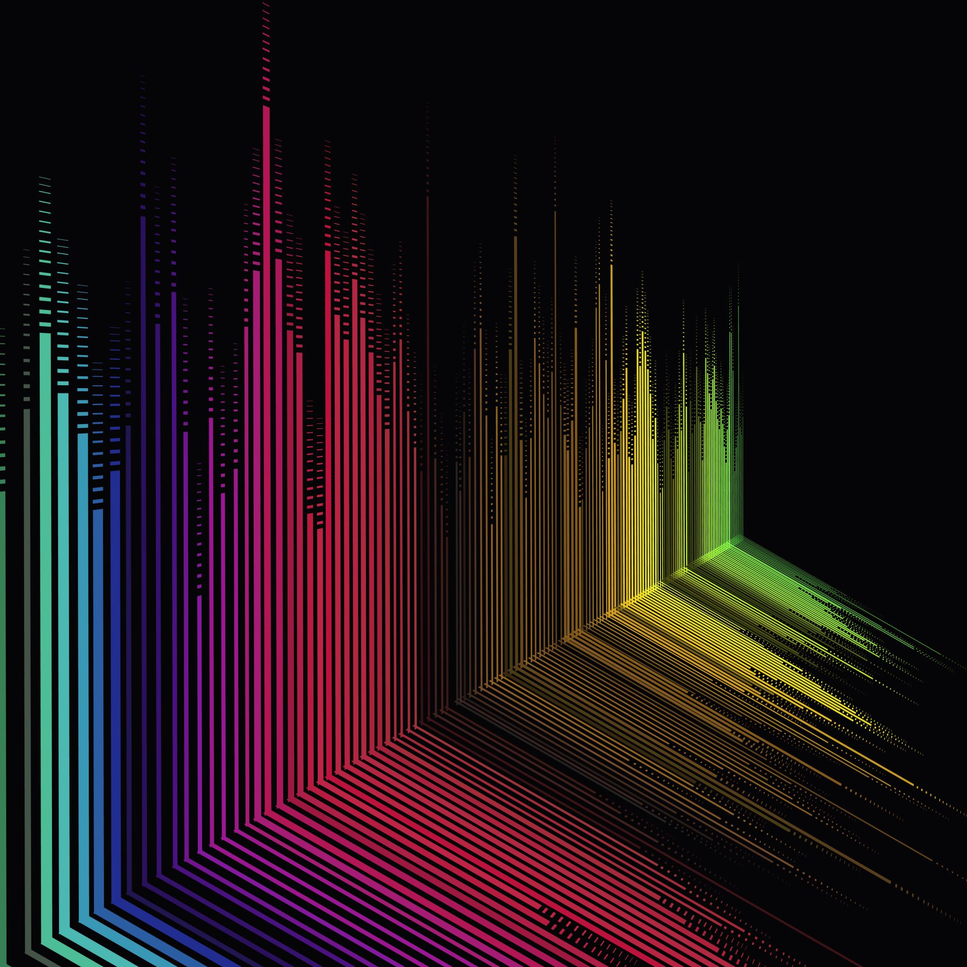
STCV-Synth
DGMD-E14 – Final Project
Harvard Extension School
Fall 2021
David Cardona
Robert Fischer

Slide 2
Agenda
Description
Demo
Architecture
Engine
Controllers
Data Analysis
Resources
Conclusions

Slide 3
Description

Slide 4
Description
STCV-Synth
First prototype in a series of accessible devices for creative expression
Audio engine controlled by a 9-DOF IMU and Computer Vision

Slide 5
Description
Purpose
Create artistic outlets for people with disabilities
Provide novel interactive approaches to interdisciplinary art performance and development

Slide 6
Demo

Slide 7
Architecture

Slide 8
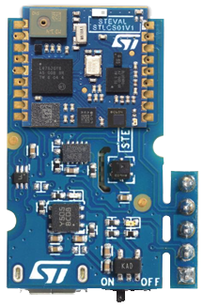

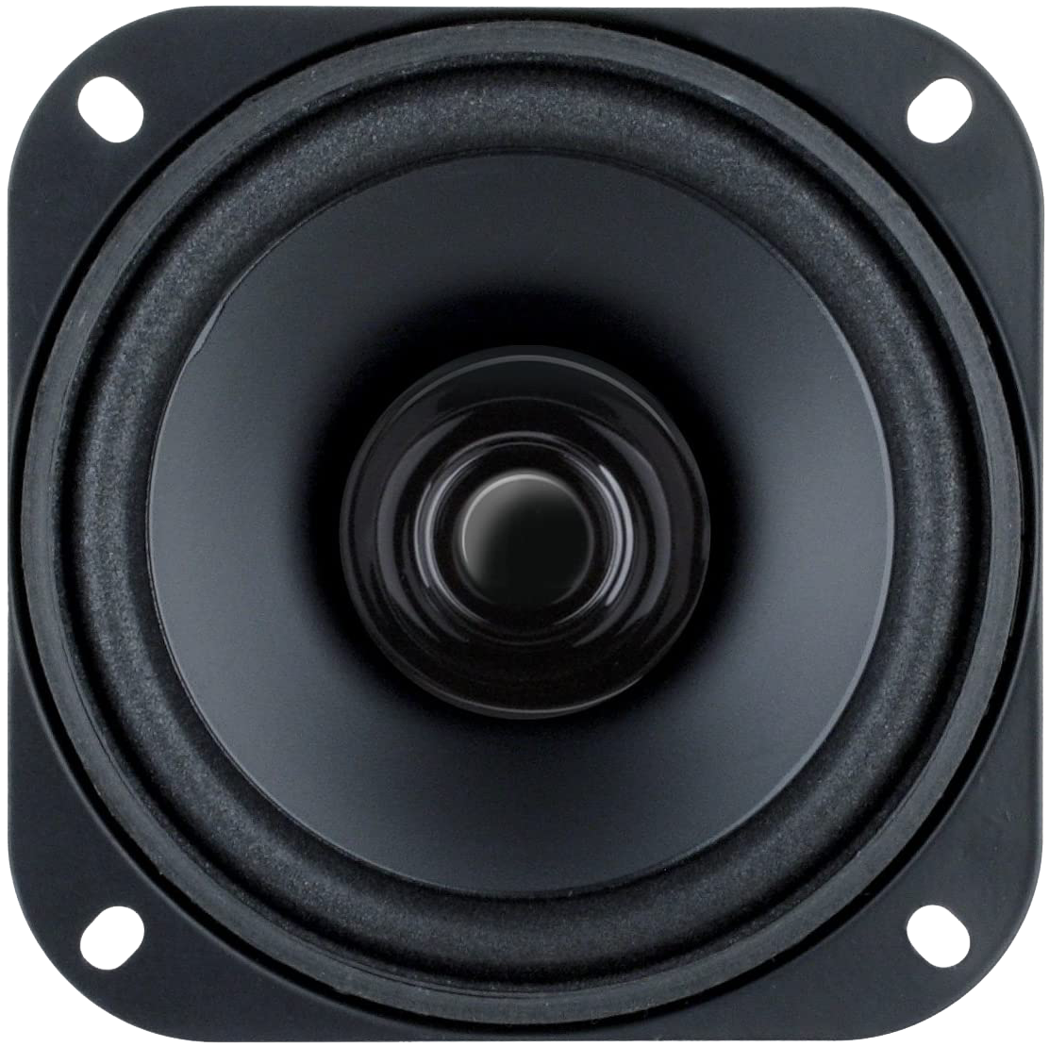
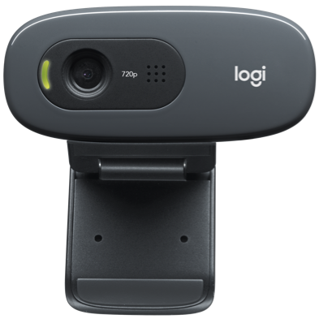
Architecture
BLE

Slide 9
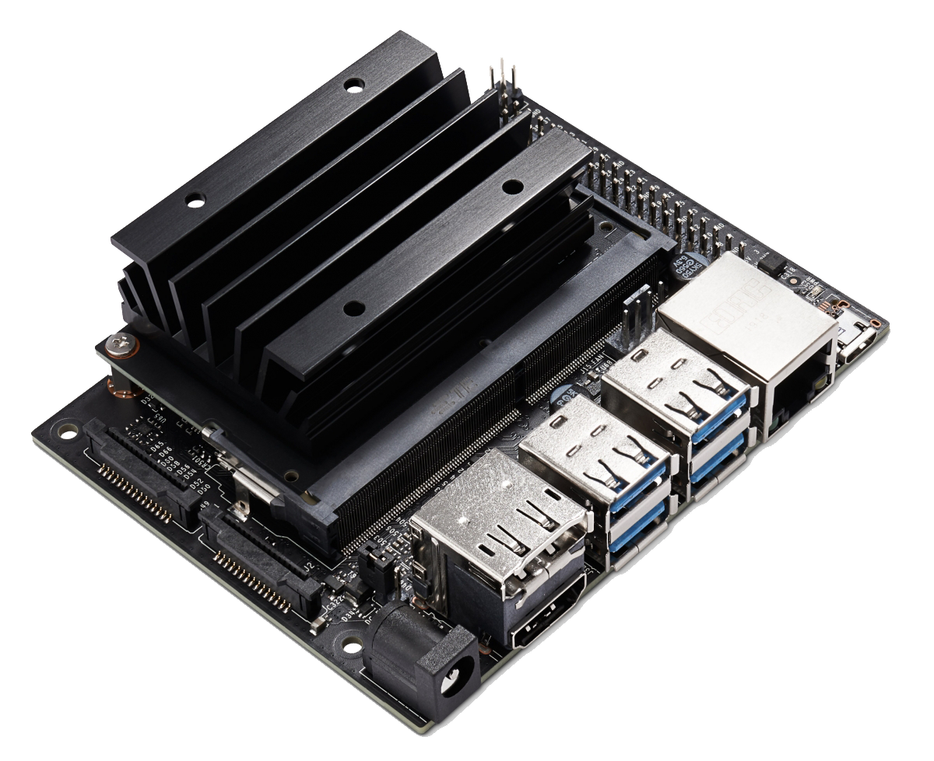
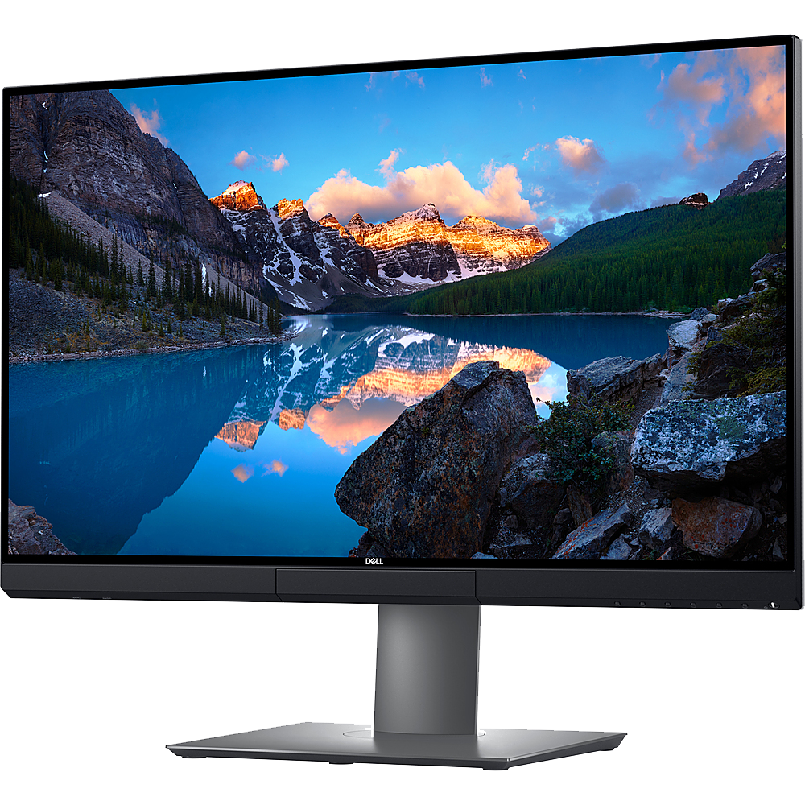
Architecture
BLE
USB
Ribbon
HDMI

Slide 10
Architecture
Materials
STMicroelectronics SensorTile*
Camera
Computer –or– NVIDIA Jetson Nano**
* Soldered to Cradle Board
** WiFi + BLE card, display, and speakers required

Slide 11
Engine

Slide 12
Engine
Overview
Audio DSP engine
Modular synthesizer component approach
Renders uncompressed audio files

Slide 13
Engine
Components
Oscillator
4th-Order Low-Pass Filter
ADSR Envelope Generator
Mixer
Long-Delay Effect
Reverb Effect

Slide 14
Engine
Signal Flow
Oscillator
Filter
Mixer
Reverb
Mapped to Gain Multiplier
Stereo Output to DAC
ADSR
Delay

Slide 15

Engine
Data-Driven Design
Scales defined as numeric series
BPM and subdivisions set as multipliers to control loop rate
$Hz=base_Hz ∗2^{({scale_step}/{12})}$

Slide 16
Controllers

Slide 17
Controllers – SensorTile
Overview
Data transmission via BLE GATT
Motion and Quaternion characteristics*
10,000Hz** notification sample rate
* Recorded Datalogs
** 10ms

Slide 18

Controllers – SensorTile
Data Processing
No Data Pre-Processing
Calculation of Spherical Coordinates based on Acceleration
Calculation of Euler Angles based on relative Quaternions*
* Quaternions were calculated from the initial relative quaternion ($q_{0}=1, q_{1}=0, q_{2}=0, q_{3}=0$), computing changes in the real value ($q_{0}$) by normalizing against the vector quaternion (i.e., imaginary components).

Slide 19

Controllers – SensorTile
Spherical Coordinates – Motion
Radial Distance $ρ = \sqrt{x^{2}+y^{2}+z^{2}}$
Polar Angle $θ=arccos⁡\left(\frac{acc_z}{ρ}\right)$
Azimuth Angle $φ=arctan\left(\frac{acc_y}{acc_x}\right)$

Slide 20

Controllers – SensorTile
Euler Angles – Quaternions
Roll $φ =arctan\frac{2(q_{0}q_{1}+q_{2}q_{3})}{1−2({q_{1}}^{2}+{q_{2}}^{2})}$
Pitch $θ=arcsin⁡(2\left(q_{0}q_{2}−q_{3}q_{1}\right))⁡$
Yaw $ψ=arctan\frac{2(q_{0}q_{3}+q_{1}q_{2})}{1−2({q_{2}}^{2}+{q_{3}}^{2})}$

Slide 21

Controllers – SensorTile
Mapping of Spherical Coordinates
$ρ$ – ADSR Attack*, ADSR Amp. Multiplier, ADSR Duration*, Delay mixer channel volume
$θ$ – LPF Cutoff Frequency
$φ$ – Reverb Dry/Wet Balance
* Inverse Proportion

Slide 22
Controllers – OpenCV
Overview
Custom GUI
Hand recognition

Slide 23
Controllers – OpenCV
GUI Elements
Buttons
Slider
Toggle
Menu

Slide 24
Controllers – OpenCV
Hand Recognition
Index fingertip extraction
Conversion to 2D point
Bounding boxes around GUI elements
AABB 2D collision detection

Slide 25
Data Analysis

Slide 26
Data Analysis
Overview
Search correlations in the datalogs
Found and graphed correlations
High correspondence in acceleration data
Identification of non-linear trigonometric identities

Slide 27
Data Analysis
Cleanup
DISCUSS HOW DATA WAS CLEANED

Slide 28
Data Analysis
Processing
DISCUSS HOW DATA WAS PROCESSED

Slide 29
Data Analysis
Visualization
DISCUSS HOW DATA WAS VISUALIZED

Slide 30
Data Analysis
Observations
DISCUSS CONCLUSIONS FROM DATA ANALYSIS

Slide 31
Resources

Slide 32
Resources
Python Libraries
AsyncIO – Asynchronous concurrent code
Threading – Thread-based parallelism

Slide 33
Resources
Third-Party Libraries – Synth
Bleak – BLE cross-platform connectivity
MediaPipe
Numpy
OpenCV
Pandas
Pyo – Audio DSP
Shapely – Analysis of planar geometric objects

Slide 34
Resources
Third-Party Libraries – Analysis
Jupyter Notebooks
MatPlotLib
Numpy
Pandas
Sci-Kit Learn – Machine learning and correlations
TensorFlow and Keras

Slide 35
Conclusions

Slide 36
Conclusions
Conclusion 1
Conclusion 2
Conclusion 3

Slide 37
Conclusions
Future – Features
Polyphony
Euler angles based musical gestures
Sustain mode
Multi-sensor operation

Slide 38
Conclusions
Future – Optimization
Improve OpenCV execution
Decouple async queues for real-time improvements
Cross-platform GPU acceleration
Port to multi-thread compatible language

Slide 39
Conclusions
Next Prototype
Video synthesizer engine

Slide 40
Thanks!

